Slide 1
NODE.JS
(The Backend Of MERN Stack)
Lecture 13

Slide 2
Today’s Agenda
Types of npm installs
Local installation V/s Global installation
When to use which ?
Introduction to nodemon

Slide 3
Types of npm install
When we install a package using npm we can perform two types of installation:
Local Installation
Global Installation
Let’s understand each of them in detail.

Slide 4
Local installation
Local installation means that the npm module gets installed in the directory where we run the command npm install <package-name> and they are put in the node_modules folder under this directory.
Syntax:
npm install <package-name>
For a particular version:
npm install <package-name>@version number

Slide 5
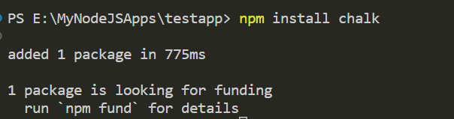
example
Example of local installation of chalk module:

Slide 6
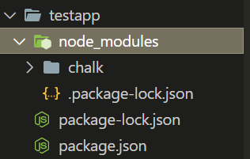
example
Location of chalk module:

Slide 7
global installation
Global installation means packages are stored in a particular place in the user’s computer regardless of where the installation command is executed.
Syntax:
npm install –g <package-name>
npm install <package_name> -g
npm install <package_name> --global
Example:
npm install –g express

Slide 8
Location of globally installed packages
On macOS computers, all the global packages will be installed under /usr/local/lib/node_modules.
On Linux computers, the global install location is /usr/local/lib/node_modules as well.
On Windows computers, global npm packages are installed under the roaming/ folder.

Slide 9

Listing the packages
To check the locally installed packages and their dependencies, we need to go to the project folder in the terminal and run the command:
npm list
OR
npm ls
Example

Slide 10
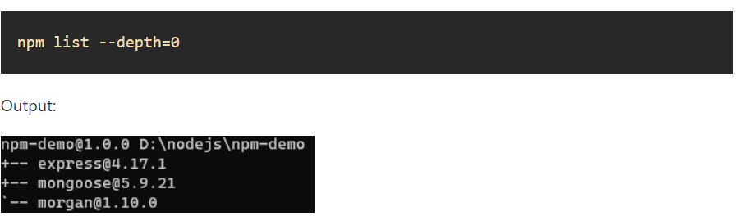
Listing the packages
To limit the dependency tree, we need to add a flag by the name of --depth
For example the following command lists all installed packages without their dependencies.
Example

Slide 11

Listing the packages
To check the globally installed packages and their dependencies, we need to go to the terminal and run the command:
npm list -g
Example

Slide 12
updating a package
Use the following command to update a package in your project.
Syntax for updating local package:
npm update <package_name>
Syntax for updating gloal package:
npm update –g <package_name>
Example:
npm update chalk

Slide 13
Uninstalling a package
Use the following command to remove a package from your project.
Syntax for uninstalling local package:
npm unistall <package_name>
Syntax for uninstalling gloal package:
npm unistall –g <package_name>
Example:
npm uninstall chalk

Slide 14
Local or global ?
In our code, both the local and global packages are imported in the same way:
require('package-name')
This raises a question that when should we install in one way or another?

Slide 15
Local should be preferred
In general, all packages should be installed locally.
This makes sure we can have dozens of applications in our computer, all running a different version of each package if needed.

Slide 16
Local should be preferred
Updating a global package would make all our projects use the new release, and this might cause problems in terms of maintenance, as some packages might break compatibility with further dependencies, and so on.
All projects have their own local version of a package, even if this might appear like a waste of resources, it’s minimal compared to the possible negative consequences.

Slide 17
When should we go for global installation ?
A package should be installed globally when it provides an executable command that we can run from the shell (CLI), and it’s reused across projects.
Some great examples of popular global packages are
nodemon
forever
mocha

Slide 18
What is nodemon ??
nodemon is a tool that helps us develop Node.js-based applications by automatically restarting the node application when the file changes in the directory are detected.
nodemon does not require any additional changes to our code or development method.

Slide 19
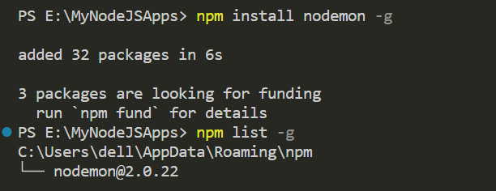
Installing nodemon
To install the nodemon module globally the command will be:
> npm install nodemon -g

Slide 20
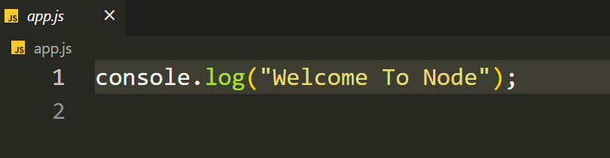
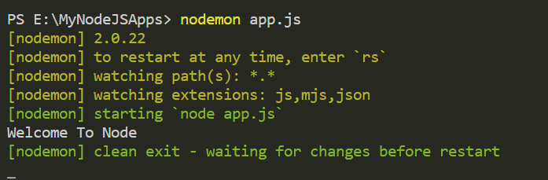
Using nodemon
To use nodemon, we just have to replace the word node with nodemon on the command line while executing our script.

Slide 21
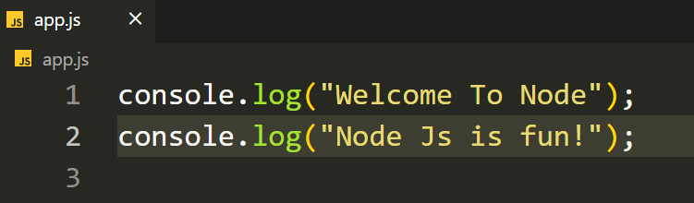
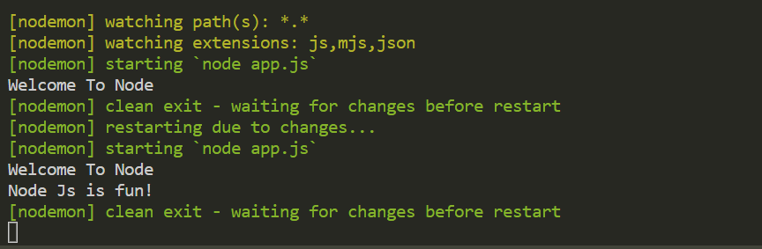
Using nodemon
Make some changes in the code and save it and nodemon will automatically re-run the script

Slide 22
What is Semantic versioning ?
Semantic Versioning (also called SemVer) is a popular versioning scheme that is used by a vast amount of open-source projects to communicate the changes included in a version release.
Semantic Versioning (SemVer) was proposed by Tom Preston-Werner in 2013 to specify how version numbering should be controlled.

Slide 23
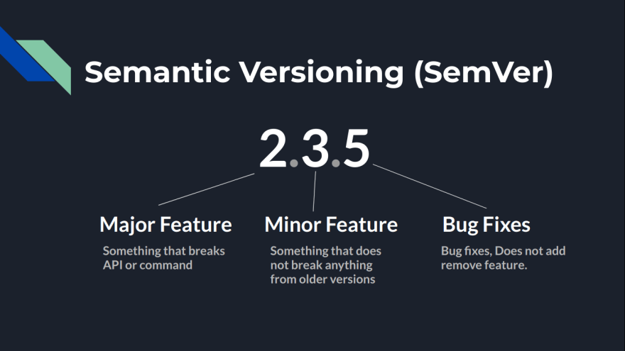
Semantic versioning

Slide 24
Understanding semver
A semantic version has three numbers and starting from right most , they are called:
Patch Version
Minor Version
Major Version

Slide 25
Understanding semver
Bug fix/patch version
Includes bug fixes/documentation spelling mistakes etc.
Minor version
Includes additions of new functions or API which does not break anything from the older versions So anything that runs on v1.1.0 should work on v1.9.0 as well.
Major version
Includes version which breaks stuff. It can include removing APIs or changing names of functions so anything that works on v1.0.0 may not necessarily work on v2.0.0

Slide 26
What is ^ ?
So we can see that , after every dependency listed under package.json there's a number which is the version of that package .
But before the version, there is a symbol of ^ and it is called Caret.

Slide 27
What is ^ ?
A ^ sign before the version tells npm that if someone clones the project and runs npm install in the directory then install the latest minor version/patch version of the package in his node_modules.
So lets say we are having the package chalk with ^5.2.0 in package.json and then chalk team releases version 5.3.0 and now when someone clones our repo and runs npm install in their directory they will get the version 5.3.0 .

Slide 28
Alternate way of ^
Another syntax to specify this version without using the caret character is like this, 5.x.
So these two are equal: ^5.2.0 or 5.x .

Slide 29
What is ~ ?
The symbol of ~ is called tilde and if we see an entry in package.json as : ~5.2.0 then it means that we're interested in any versions as long as the major version is 5, and the minor version is 2.
And the alternate syntax to specify this version is like this 5.2.x

Slide 30
Conclusion
So we can see that the caret and the tilde characters help us keep the applications up to date, with the latest releases of these dependencies.

